Slide 1
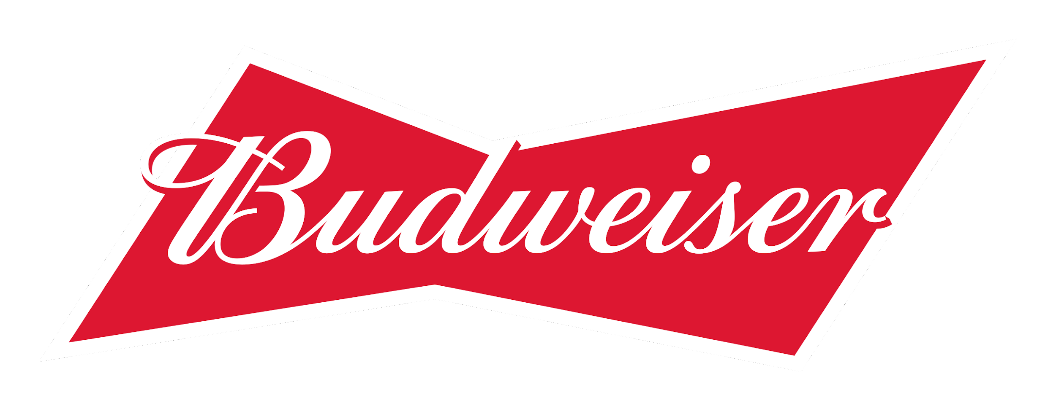
Beer and Breweries Case Study
William Jones and Christian Orji

Slide 2
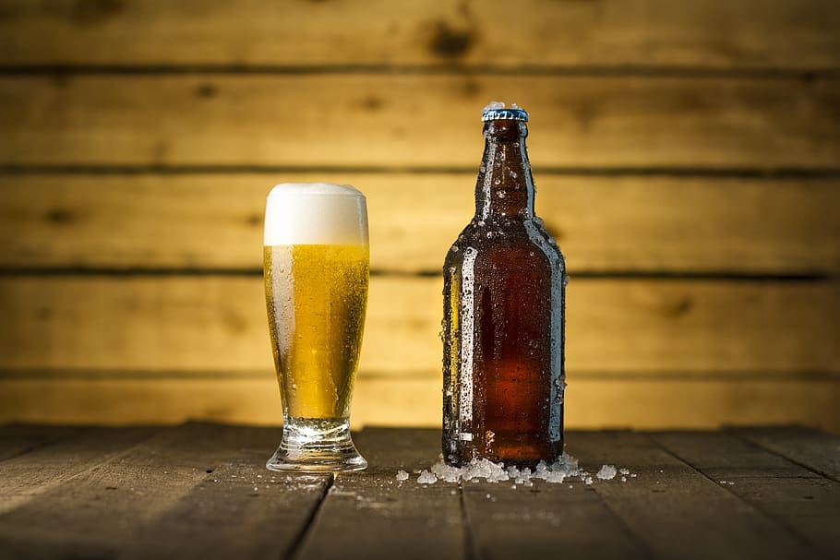
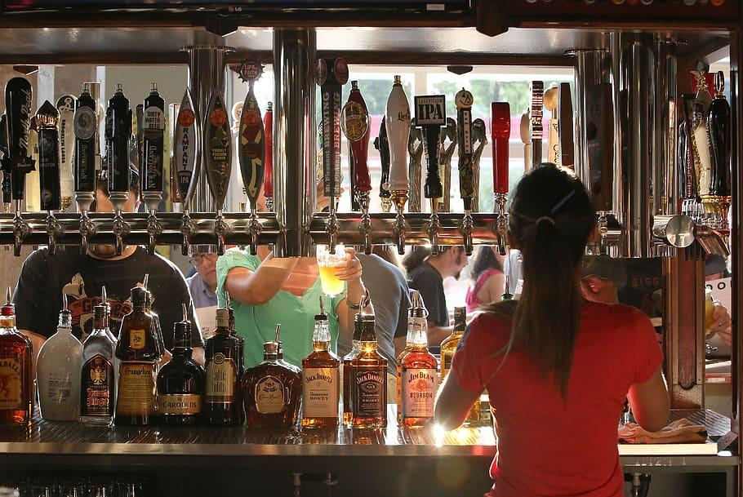
The Data
Beers
Breweries
Beer Name
Beer ID
ABV
IBU
Brewery ID
Style
Ounces
Brewery Name
Brewery ID
City
State

Slide 3
Challenges
Missing Data
Duplicates
Combining Datasets
ABV and IBU columns
There were 62 beers that were missing an ABV value.
1005 beers were missing their IBU.
Beers listed more than once
Of the 2411 beers provided there 83 beers listed more than once.
Beers and Breweries
Both files contained similar columns that were under different names.

Slide 4
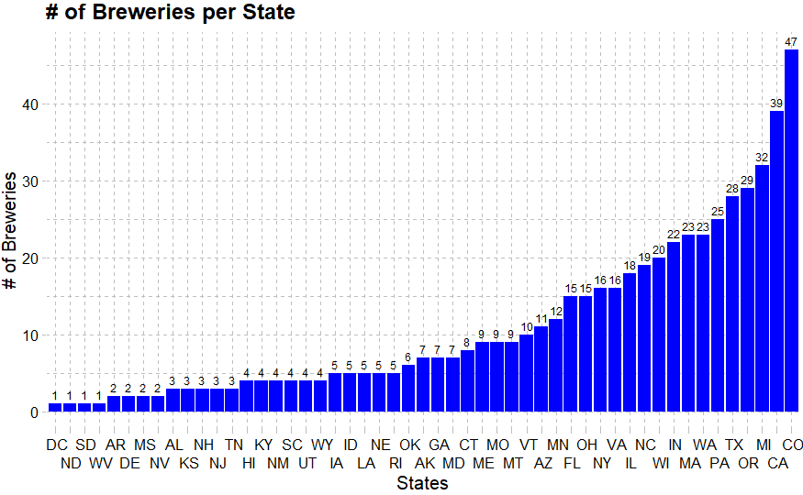
Breweries
max growth
Top: Colorado (47 Breweries)
Bottom: DC, SD, ND, WV (1)

Slide 5
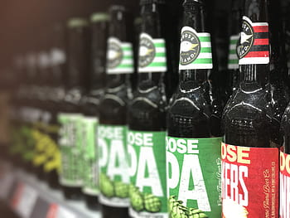
Missing Values
Initially
After Imputing
ABV:
IBU :
Style
62
1005
5
18
514
3
To address missing values data was first attempted to be filled in by searching the website untappd.com based on Beer Name, Brewery, ABV for IBU and Beer Name, Brewery for ABV.
Removed duplicated beers to now only 2304 from the initial list of 2411 beers

Slide 6
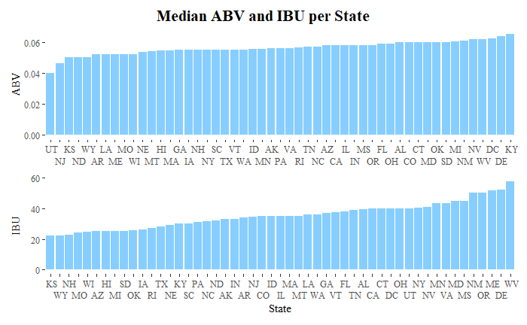
Top Median ABV:
Kentucky
Delaware
District of Columbia
Top Median IBU:
West Virginia
Delaware
Maine

Slide 7
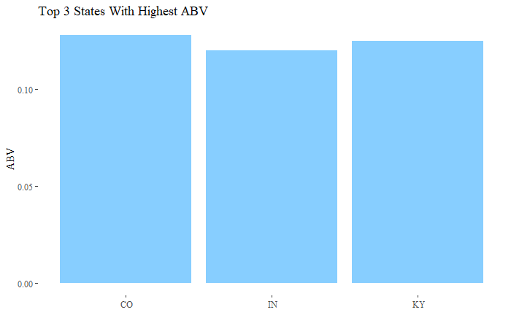
Top 3 States With The Highest ABV
!
1
3
2
Colorado - Lee Hill Series Vol. 5 - Belgian Style Quadrupel Ale (12.8%)
Kentucky - London Balling (12.5%)
Indiana - Csar (12%)

Slide 8
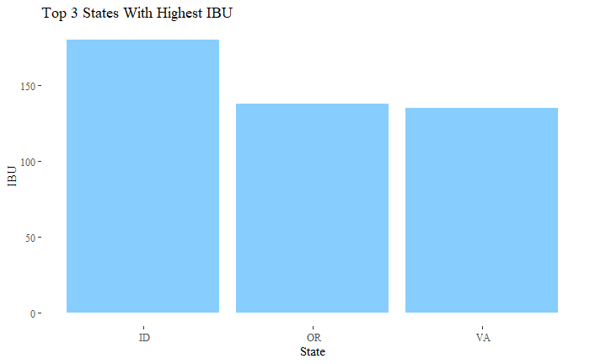
Top 3 States With Highest IBU
1
2
3
Idaho - Double Dagger (180)
Oregon- Bitter Bitch (138)
Virginia - Trooper’s Alley (130)

Slide 9
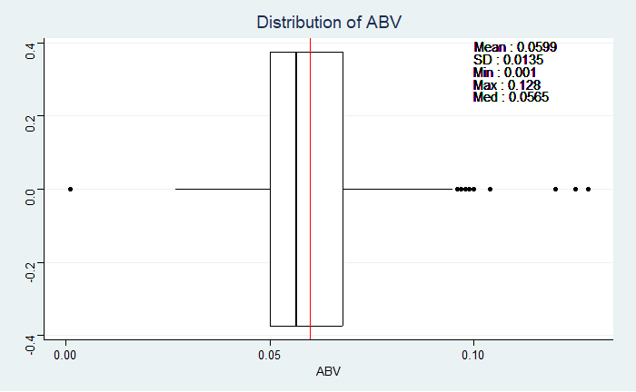
Alcohol By Volume
In the list of beers the lowest ABV is 0.01% and the highest ABV is 12.8%.
Most beers seem to contain around 6% ABV

Slide 10
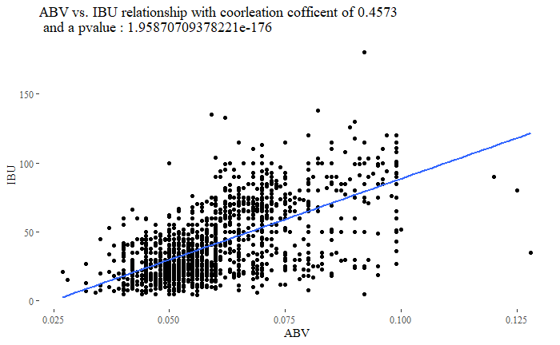
Relationship of IBU and ABV
There seems to be evidence of a moderately positive relationship between a beer’s ABV and IBU.

Slide 11
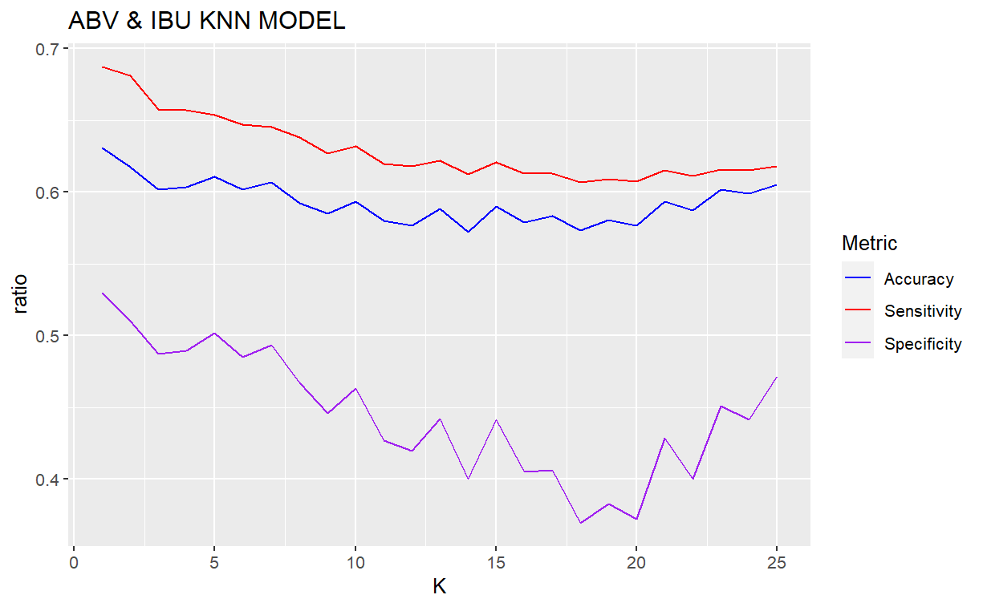
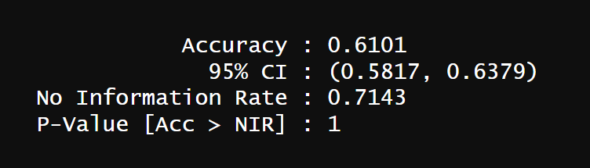
Predicting Beer Style with ABV and IBU
Knn model was used for the classification.
A K of 3 was chosen to avoid underfitting and overfitting.
Model was able to predict Beer Style with some accuracy and found that there was a slight agreement between ABV and IBU
 | ALE | IPA
ALE | 556 | 170
IPA | 294 | 170

Slide 12
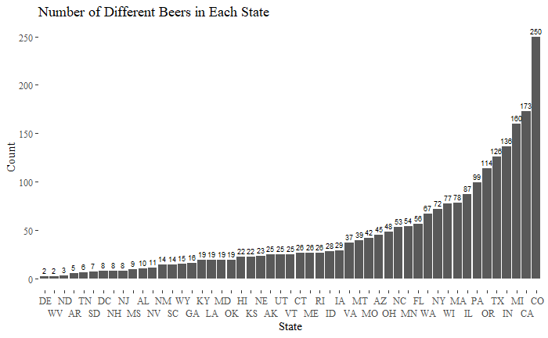
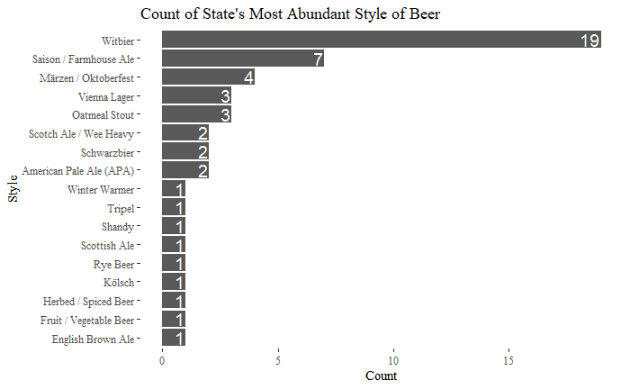
Beers and States
Looking at the dataset we were able to see which states have the most variety of beers
A count of was taken by looking at each state’s top beer style with most variety of beers and adding each of those up
Colorado (250 Beers)
California (173 Beers)
Minnesota (160 Beers)
Witbier (19 States)
Saison (7 States)
Marzen / Oktoberfest (4 States)

Slide 13
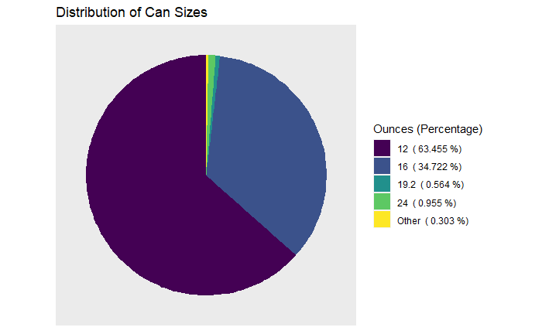
Beer Can Sizes
Over half of beer can sizes come in 12 ozs
Majority of the rest of the beers are in 16 ozs

Slide 14
Conclusion
Most preferable can size is 12 oz and 16 oz cans
Most beers have a ABV around 6%
Northwest region has the most bitter beers
There is a evidence of a moderately positive relationship between ABV and IBU
Room for expansion of beers in states such as DC, WV, ND, AR, TN

Slide 15
Thank You
Questions
William Jones
wfjones@mail.smu.edu
Christian Orji
corji@mail.smu.edu

Slide 16
Youtube Video Presentation
https://www.youtube.com/watch?v=7q98zS8Fg74

